Slide 1
Cucumber (Behaviour Driven Development)
Session 1 Anshul Sonpure

Slide 2
Topic of discussion
Introduction to Behavior Driven Development (BDD)
What is BDD?
Why BDD?
BDD vs TDD
Introduction to Cucumber
What is Cucumber?
How does Cucumber work?
Cucumber Gherkin Syntax
Installing and Setting Up Cucumber

Slide 3
Introduction to Behavior Driven Development (BDD)
Behavior Driven Development (BDD) is a software development approach that combines the principles of Test Driven Development (TDD) and Domain Driven Design (DDD).
It is a collaborative approach that involves stakeholders, developers, and testers in the software development process.
BDD focuses on the behavior of the software and its interactions with various components in the system.

Slide 4
What is BDD?
BDD is a methodology that encourages collaboration between developers, testers, and business stakeholders to ensure that the software meets the requirements of the stakeholders.
It emphasizes on defining and understanding the behavior of the system and its interactions with different components.
BDD scenarios are written in a natural language format, making them easily understandable to stakeholders, including non-technical users.

Slide 5
Why BDD?
BDD helps in bridging the communication gap between stakeholders, developers, and testers.
It helps stakeholders to better understand the requirements of the system, and developers to write code that meets those requirements.
It also ensures that the system is thoroughly tested and meets the business requirements.
BDD scenarios written in natural language format are easy to understand by non-technical users and can help in reducing the ambiguity in the software development process.

Slide 6
BDD vs TDD
TDD is a software development approach that focuses on writing automated tests for each functionality before writing the actual code.
The primary focus of TDD is to ensure that the code meets the requirements and passes all the tests. On the other hand, BDD focuses on defining and understanding the behavior of the system and its interactions with various components.
BDD scenarios are written in a natural language format, making them easily understandable to stakeholders, including non-technical users. While TDD is focused on testing the functionality of the code, BDD is focused on the behavior of the system as a whole. BDD helps in bridging the communication gap between stakeholders, developers, and testers, whereas TDD mainly focuses on the developer's perspective of the code.

Slide 7
What is Cucumber?
Cucumber is a behavior-driven development (BDD) framework that allows developers and testers to write tests in plain English text.
It supports the creation of test cases that are easily understandable by all stakeholders, including developers, testers, and business analysts. Cucumber enables you to write acceptance tests, which test the behavior of your application based on user stories or scenarios.
The tool supports many programming languages such as Java, Ruby, and JavaScript, and can integrate with different testing frameworks like Selenium and Appium.

Slide 8
How does Cucumber work?
Cucumber works by using a plain text language called Gherkin to describe the behavior of the system.
Gherkin provides a simple syntax for writing feature files, which are then translated into executable test cases by Cucumber.
The feature files contain a set of scenarios, each of which has a set of steps that describe the behavior of the system.
These steps can be defined using step definitions, which are written in a programming language like Java. Cucumber executes the test cases by matching the steps in the feature files to the step definitions in the code.

Slide 9
Cucumber Gherkin Syntax
Gherkin is a simple and easy-to-understand syntax used in Cucumber that enables you to write test cases in a natural language that can be easily understood by all stakeholders. The syntax is based on three main elements: feature, scenario, and steps.
The feature element is used to define the functionality of the system that you want to test. It contains a brief description of the feature and an optional list of tags that can be used for filtering and grouping.
The scenario element is used to define a specific test scenario for the feature. It contains a brief description of the scenario and an optional list of tags.

Slide 10
Cucumber Gherkin Syntax
The steps element contains a series of steps that describe the behavior of the system for a specific scenario. Each step is written in a natural language and can be preceded by keywords like Given, When, and Then, which help to define the order of the steps.
Feature: Login Feature
Verify if user is able to Login in to the site
Scenario: Login as a authenticated user
Given user is on homepage
When user navigates to Login Page
And user enters username and Password
Then success message is displayed

Slide 11
Installing and Setting Up Cucumber
In order to install Cucumber on your system, you would need some basic installations on your system:
Set up JDK on your system (JDK 1.8 or the latest version)
Install Eclipse (Eclipse OXYGEN or the latest version)
Install Cucumber plugin:
In Eclipse, go to Help → Install new software
On the Available Software popup, enter the URL “ http://cucumber.github.com/cucumber-eclipse/update-site ” in the Work with field.
You will see “Cucumber Eclipse Plugin” displayed in the filter; select the checkbox and click Next, and you will navigate to the Install Details popup. Click Next to proceed further.
Accept the license in the Review License pop-up and click Finish.

Slide 12
Installing and Setting Up Cucumber
Now, in order to build a Selenium-Cucumber framework for us to work with, we need to add dependency for Selenium and Cucumber in pom.xml
Dependencies-
Selenium-java
Cobertura
Cucumber-jvm-deps
Cucumber-reporting
Gherkin
JUnit
Mockito-all-1.10.19
Cucumber-core
Cucumber-java
Cucumber-junit

Slide 13
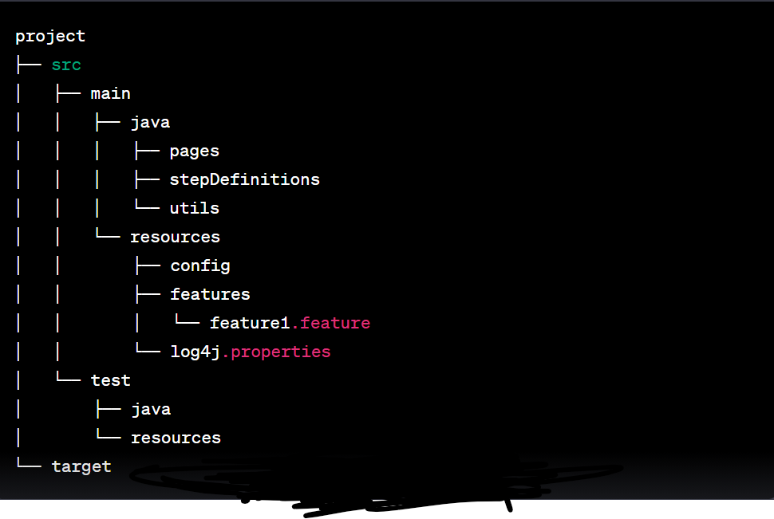
Installing and Setting Up Cucumber
Folder Structure for Cucumber Framework

Slide 14
Installing and Setting Up Cucumber
Folder Structure for Cucumber Framework
src/main/java/pages: contains classes for page objects used in the tests
src/main/java/stepDefinitions: contains step definition classes for Cucumber scenarios
src/main/java/utils: contains utility classes, such as property readers and driver managers
src/main/resources/config: contains configuration files such as config.properties and log4j.properties
src/main/resources/features: contains feature files that define the behavior of the application
src/main/resources/features/feature1.feature: example feature file
src/test: empty folder for test-related files
target: folder for compiled classes and test reports

Slide 15
Summary of topics covered
BDD stands for Behavior Driven Development.
It is an agile software development methodology that aims to enhance collaboration between developers, QA, and non-technical stakeholders.
BDD focuses on the behavior of the application from the perspective of the end-users.
Cucumber is a BDD tool that helps bridge the gap between technical and non-technical stakeholders.
It allows stakeholders to write tests in plain English using the Gherkin syntax.
Cucumber reads test scenarios written in Gherkin syntax.
It maps each scenario to a step definition written in code.
Cucumber executes the step definitions to perform the test actions.

